Slide 1


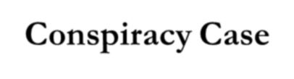
TOPIC :
Agartala Conspiracy Case
Prepared by Mallika Datta Lecturer at EDS
United International University

Slide 2
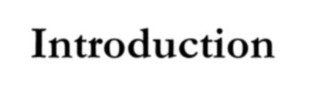
Introduction
Agartala Conspiracy Case a case framed by the Pakistan Government in 1968 during the Ayub regime against Awami League chief sheikh mujibur rahman, some in-service and ex-service army personnel and high government officials.
They were accused conspiracy to secede
of involvement in a the East wing from
Pakistan with the help of the government of India.

Slide 3
The petitis principii in the petition was that the conspiracy was concocted between the Indian party and the accused persons at Agartala city of Tripura in India. The case was thus called
Agartala Pakistan withdraw
Conspiracy Case. government was the case in the
However, the compelled to face of a mass
movement in East Pakistan.

Slide 4
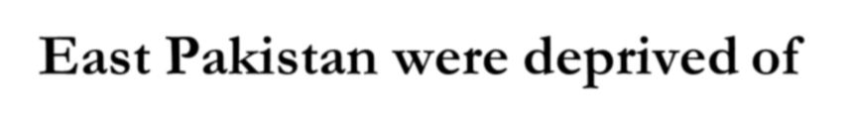
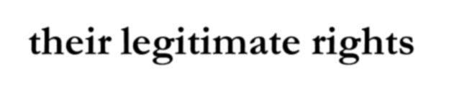
East Pakistan were deprived of their legitimate rights
Since the inception of Pakistan, the people of East Pakistan were deprived of their legitimate rights in all spheres. Consequently, a general resentment against the Pakistani rulers brewed among the people of East Pakistan. The demand for autonomy as placed through the six-point programme of the Awami League chief Sheikh Mujibur Rahman thus received the spontaneous support of the people of East Pakistan.

Slide 5
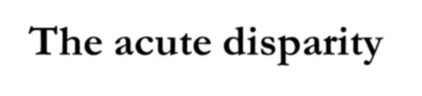
The acute disparity
The acute disparity in the armed forces led some Bangali army officers and soldiers to be united secretly. Knowing full well that the interest of the Bangalis could never be served under the rulers of West Pakistan, they decided to make East Pakistan independent through an armed revolt.

Slide 6
With this
end in view, they began to mobilise army personnel secretly. The
conspiracy was, however, detected by the intelligence department of the government. Nearly one thousand five hundred Bangalis throughout Pakistan were arrested by the intelligence force.

Slide 7
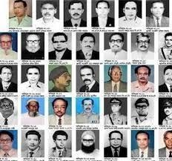

Slide 8
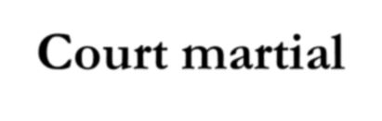
Court martial
Initially the government decided to court martial the accused, but subsequently in the interest of the proper holding of the general elections of 1970 the government resolved to frame charge only against 35 concerned political personalities and high government officials under civil law.

Slide 9
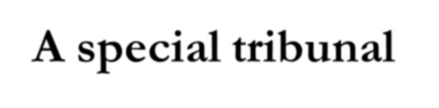
A special tribunal
A special tribunal was formed after an amendment was made in the penal code to that end for the disposal of the case. The hearing of the case started on 19 June 1968 under Sections 121-A and 131. Sheikh Mujibur Rahman was enrolled as accused No.1. The case was entitled 'State vs Sheikh Mujibur Rahman and others'.

Slide 10
The tribunal started proceedings of the case in a highly protected chamber inside Dhaka Cantonment. A charge-sheet consisting of 100 paragraphs against the 35 accused was placed before the tribunal. There were 227 witnesses including 11 approvers. However, 4 approvers were declared hostile by the government.

Slide 11
Thomas William, a British lawyer and a member of the British Parliament, filed a writ petition in Dhaka High Court on behalf of Sheikh Mujibur Rahman challenging the legality of the formation of the tribunal. He was assisted in conducting legal proceedings in the special tribunal by Abdus Salam Khan, Ataur Rahman Khan, and others.

Slide 12
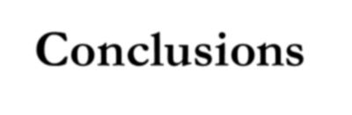
Conclusions
At a point when the streets of Dhaka became a hot bed of turmoil, Sergeant Zahurul Haq, 17th accused in the case, was mercilessly shot to death while in confinement in Dhaka Cantonment.

Slide 13


















































The news of his death led a furious mob to set fire to the State Guest House as well as other buildings. S.A Rahman, Chairman of the tribunal, and Manzur Quader, chief lawyer on the government side, who were then residing in the guest house, evacuated secretly.

Slide 14










Some of the files concerning the case were burnt to ashes. In the face of the mass movement, the Ayub government was ultimately compelled to withdraw the Agartala Conspiracy Case on 22 February 1969. All the accused, including Sheikh Mujibur Rahman, were released unconditionally.

Slide 15






























On the following day (23 February), a grand public reception was accorded to the accused at Paltan Maidan in Dhaka where Sheikh Mujibur Rahman was vested with the appellation of 'Bangabandhu'. [Shahida Begum]

